Slide 1
Drone simulation
Team members: Abya
Apurva

Slide 2
Installing Ubuntu,ROS
Started off with installing Ubuntu 20.04 in our systems as we needed Linux to use ROS.
We need an operating system to run our model for which we use ROS.
ROS is basically an open source framework that helps people build and reuse code between robotics applications.
Installed noetic version of ROS.

Slide 3
Setting up mavros
MavROS is a ROS package that provides communication driver for various autopilots with MAVLink communication protocol.
We next installed MavROS in our system.

Slide 4
Setting up PX4 and Autopilot
An autopilot is required to transmit our command to the system. PX4 is a suitable source for that.
PX4 is an open source flight control software for drones and other unmanned vehicles. It provides the required set of tools for drone developers to share technologies to create proper solutions for drone applications.
We used iris model inbuilt drone.

Slide 5
Gazebo
Installed Gazebo9-3D dynamic simulator.
It is a high class simulator that allows simulation of real-life environment. It allows us to include practical forces such as gravity and friction.

Slide 6
Writing scripts
We needed a script for takeoff of our drone. Also, a launch file was needed for the obvious purpose.
We created a python script in VS Code for this execution.

Slide 7
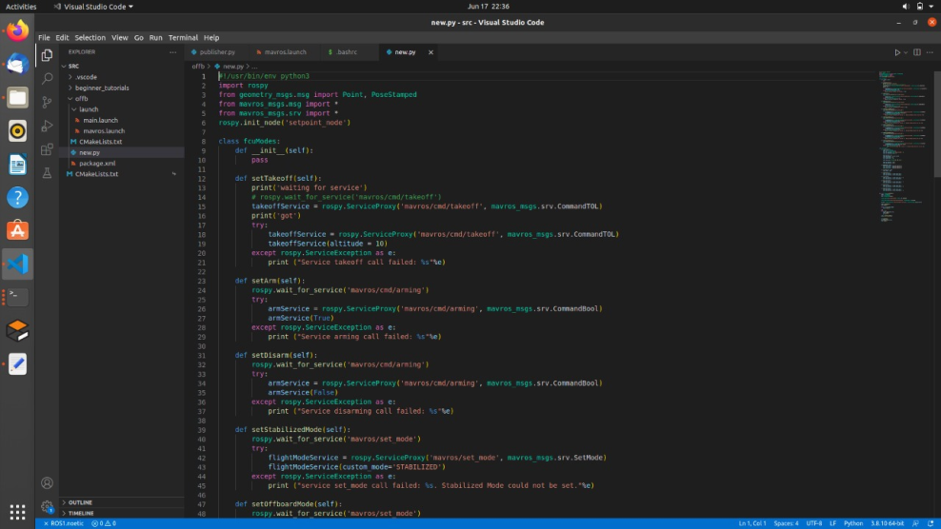
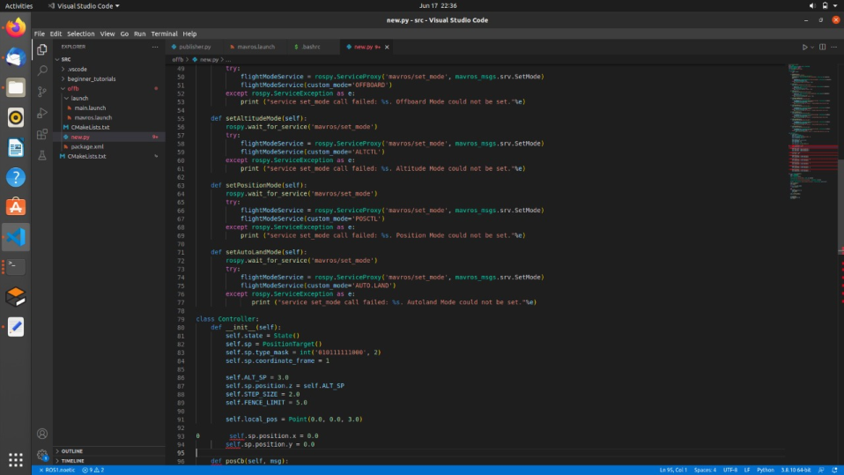
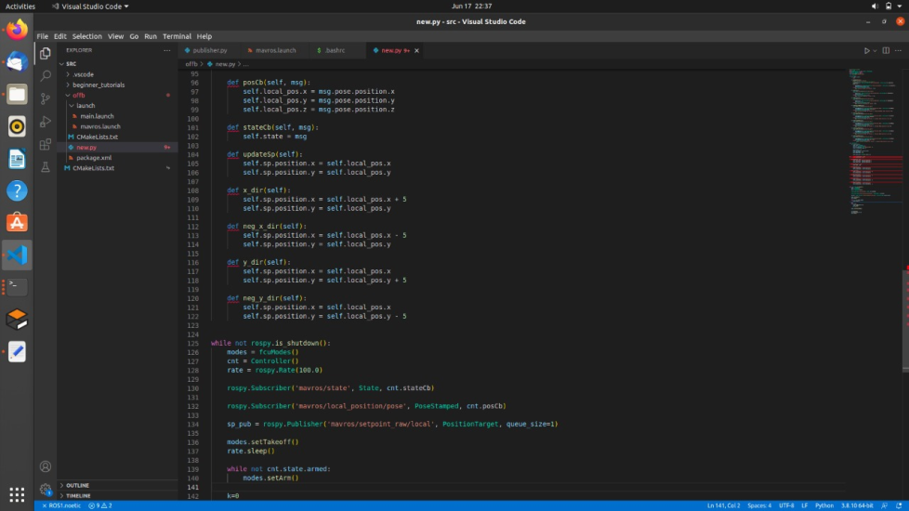
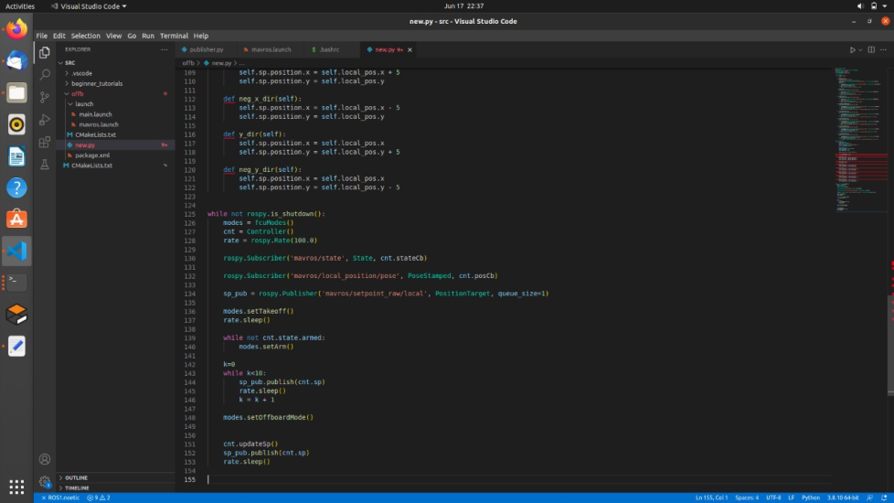
Take off script in python

Slide 8
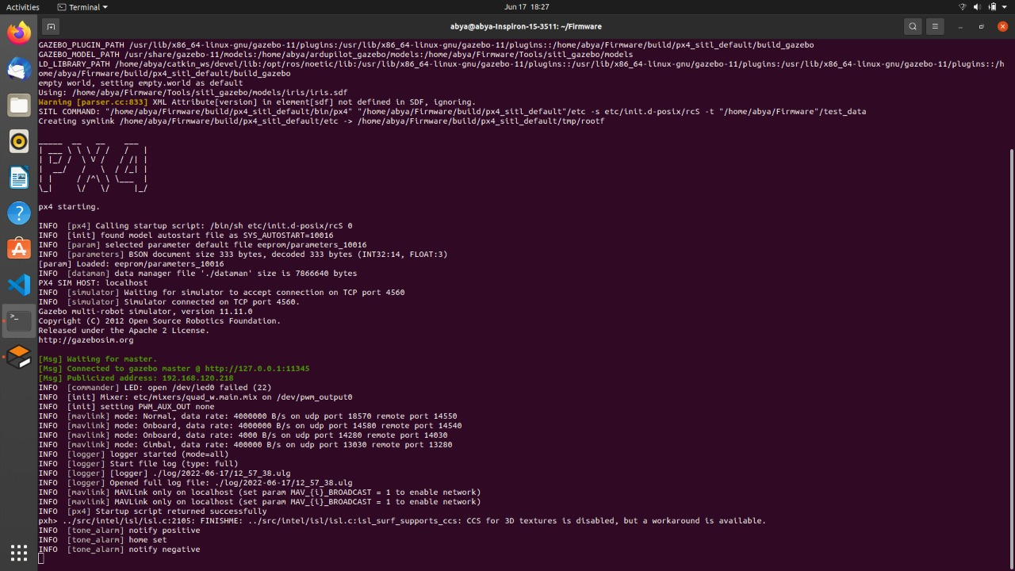
Starting PX4

Slide 9
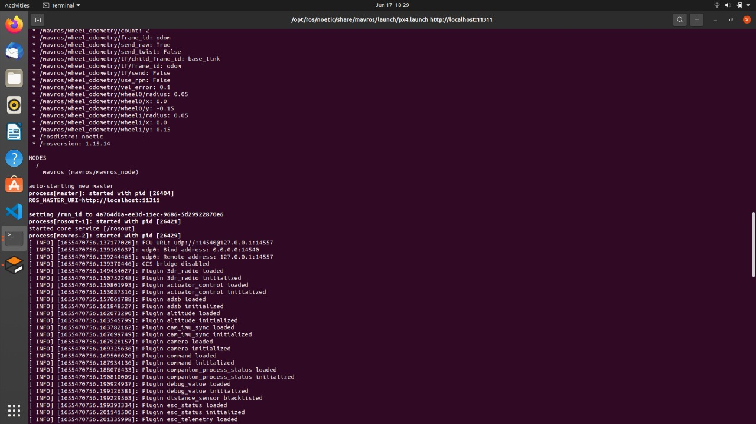
Starting mavros

Slide 10
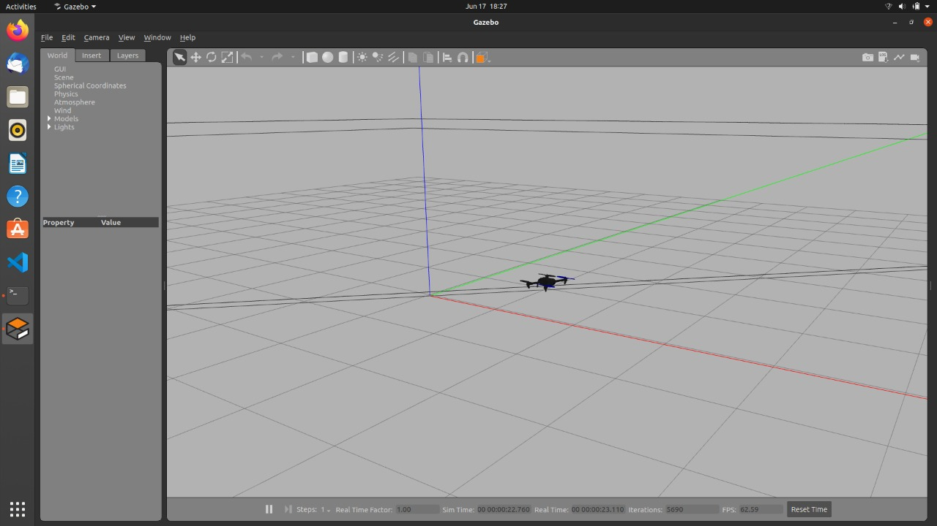
Simulation of drone

Slide 11
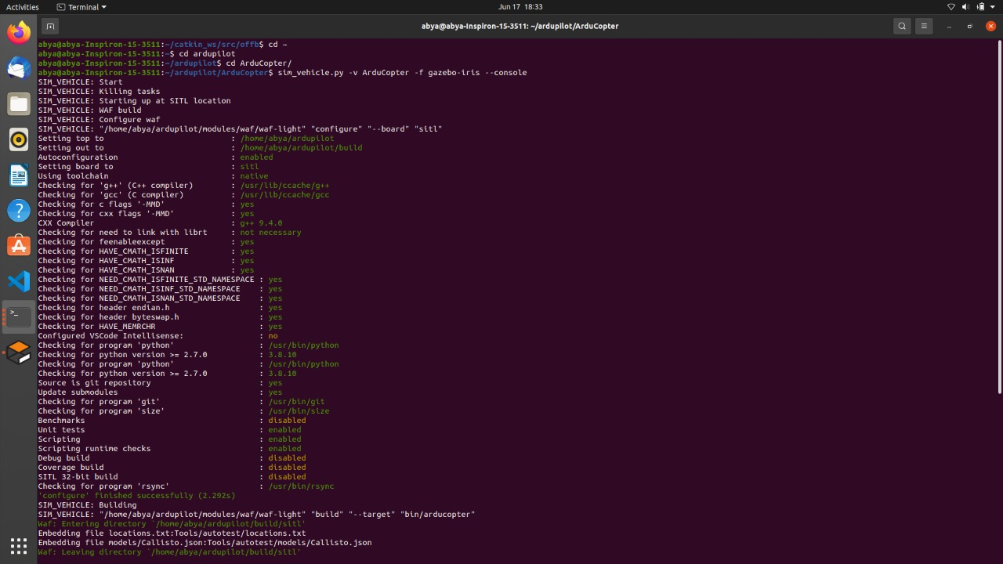
Launching sim_vehicle

Slide 12
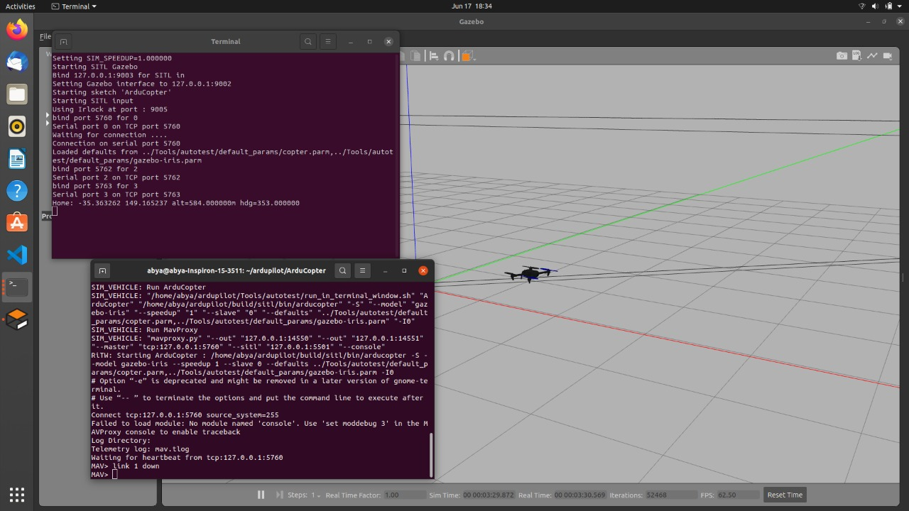
Running launch files and scripts

Slide 14
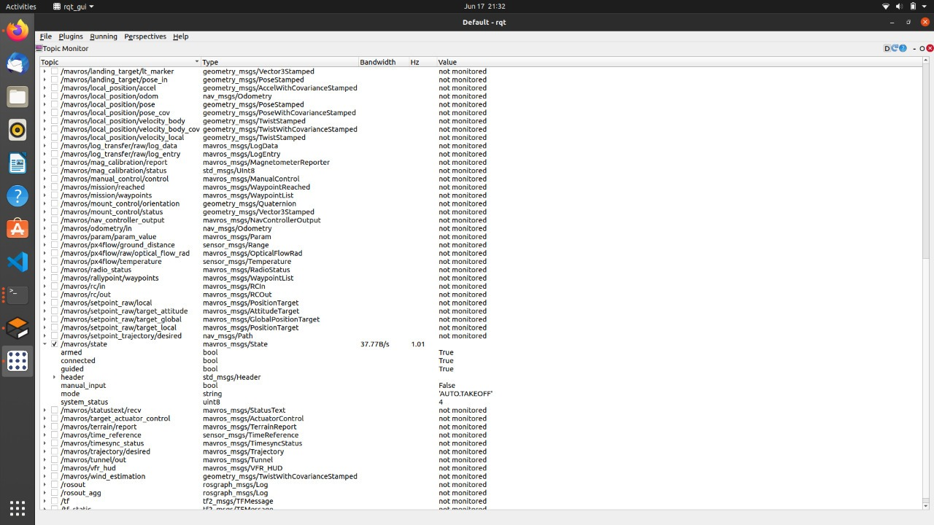
All the commands are working in the right manner

Slide 15
In the previous slide, it was visible that the drone is in right environment.
Drone is being simulated in gazebo using mavros package
It is armed and ready to take off
All the necessary commands are working fine

Slide 16
Future improvements
Guided and machine modes in noetic version of ROS.
We came to know that our system was working in auto mode which is not compatible with take off command
In future,we’ll be exploring the different modes in noetic version of ROS.

